Slide 1
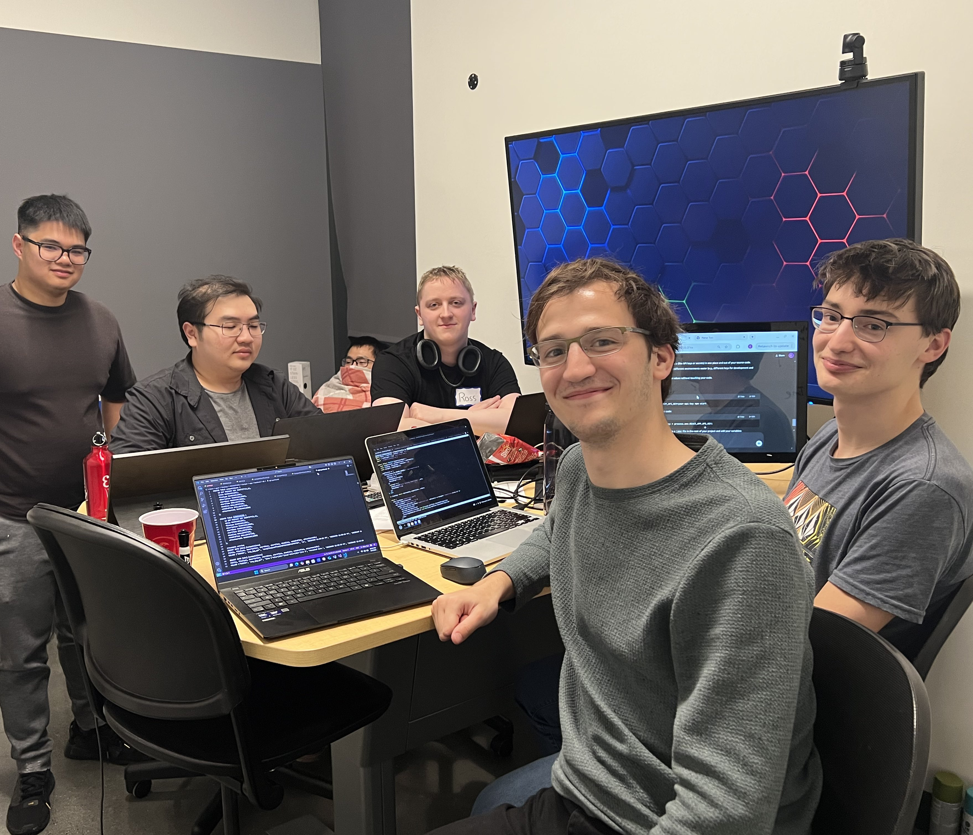
comper
Members: Dylan Gyori , Evan Gyori, Jason Nguyen, Harry Ky, Benjamin Bordon, Ross Kugler.

Slide 2
PRoject Overview
Anonymous web interaction
Competitions cover diverse categories
Includes discussion threads

Slide 3
ThE Issue of Privacy in the digital age
The Problem
Personal data is being collected, tracked, and monetized
Identity theft and data breaches
Unwanted surveillance
Doxxing and Cyberbullying

Slide 4
Our Solution
Complete Anonymity
No personal data or user tracking within the app (no login system)
A unique competition-specific ID is used as the sole identifier
This system ensures anonymity and secure participation and interaction
.

Slide 5
Broader Impacts considerations
We believe our app creates a welcoming space for individuals who are naturally shy or introverted, offering them a comfortable way to connect with others who share similar interests and hobbies—while remaining anonymous.

Slide 6
Project walkthrough

